Slide 1
Parsetagram
# | User Story Title | User Story Description | Priority | Additional Features/Notes
1) | Sign up/ Sign in feature | A user can sign up and sign in through a backend Parse DashBoard | Must Have | Staying logged in across restarts and logging out
2) | Feed Stream | A user can view the Feed Stream of Posted Pictures, with the option to add comments underneath | Must Have | Pulling down to refresh and can scroll down to fetch older posts
3) | Posting Pictures | A user can post pictures with captions on them and have it saved through the backend Parse DashBoard | Must Have
4) | Profile Tab, Chat Function and export to Android and Web Development | User can create a profile section User can chat with other users Application available in Android and Web browser form so more users can use it | Should have | Optional Features, but highly recommended for more functionality

Slide 2
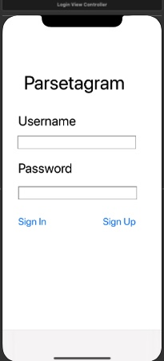
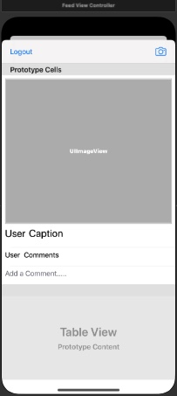
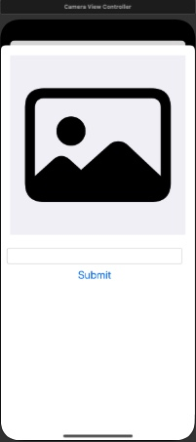
Wireframe
Description | Login Screen | Feed Stream | Camera Submit
Mockup

Slide 3
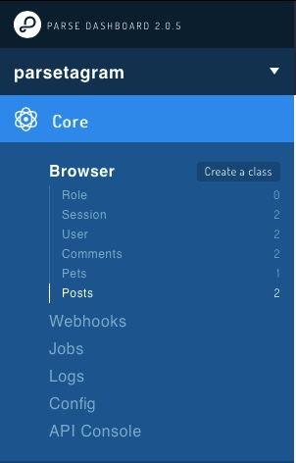
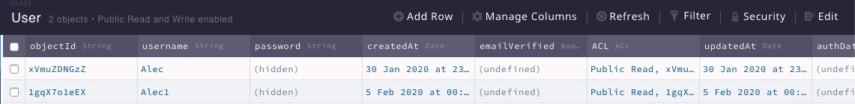
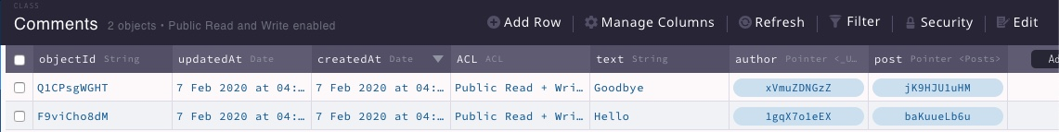
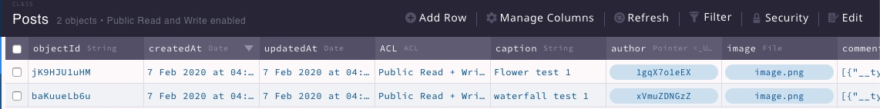
Parse Backend Dashboard

Slide 4
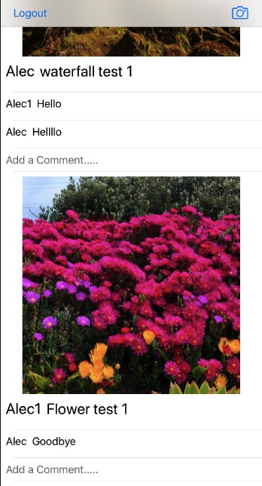
Parse Backend Dashboard (cont.)

Slide 5
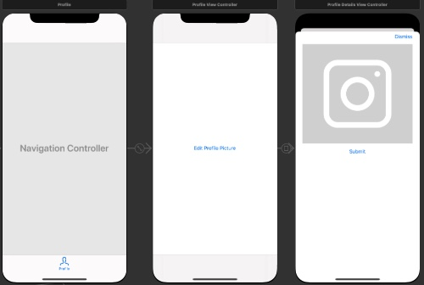
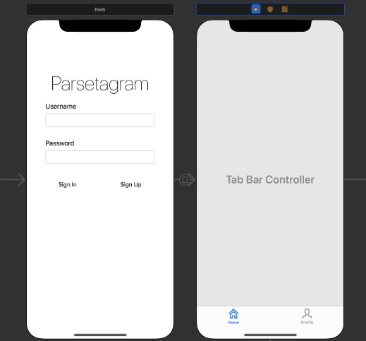
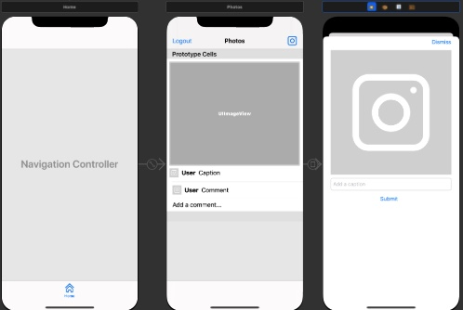
Optional Features Wireframe

